Slide 1
5 Data Types-Lists (Midterm Test)
Instructor: Raed Karim
Email: raed.karim@sheridancollege.ca
Course: PROG12583

Slide 2
Data Types-Lists
Objectives
At the end of this module, students will be able to:
Define and create List to store data.
Process and access data stored in Lists.
Write and implement List methods and functions.
Solve problems that requires data stored in Lists.

Slide 3
Working with Lists Part - 1

Slide 4

Data Types- Lists
Working with Lists
A List contains a collection of items (data).
Lists are ordered (indexed) sequences of arbitrary data (items) that is mutable.
Sequence means that a list stores items in the sequence in which they are added to the list, lists are a type of data structure known as a sequence.
Mutable means that the length of the sequence can be changed and elements can be substituted.
Lists can be of any data, of one type or mixed type, and can be written explicitly.
The basic format is a square-bracket-enclosed [ ], comma-separated list of arbitrary data.

Slide 5
Data Types- Lists
Working with Lists
You can also create an empty list. Then, you can add items to this list later on.
In some languages (like Java), this structure is referred to as an array and the items in the array are referred to as elements.
Just like strings, to refer to (and to get) an item in a list, you use an index starting at 0. The second item has an index of 1, and so on.
You can also get items starting from the end of the list by using a negative integer as the index. Then, the last item in a list has an index of -1, the second to last item has an index of -2, and so on.
You can get an item in a list and assign its value to a variable.

Slide 6
Data Types- Lists
Working with Lists
You can use the repetition operator (*) to help create a list. For example, you create a list with one item, then you use the repetition operator to repeat that item as many times as you want.
In the same way, you can add an item to a list. Here, you code the name of the list and the index that accesses the item on the left of the assignment operator (=). Then, you code the data that you want to assign to the item on the right side of the assignment operator.
If you attempt to access an item that doesn’t exist in the list, you’ll get an IndexError that indicates that the index is out of range.

Slide 7
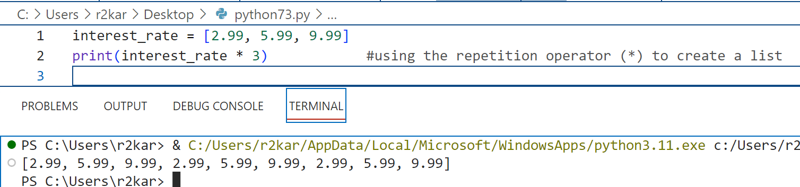
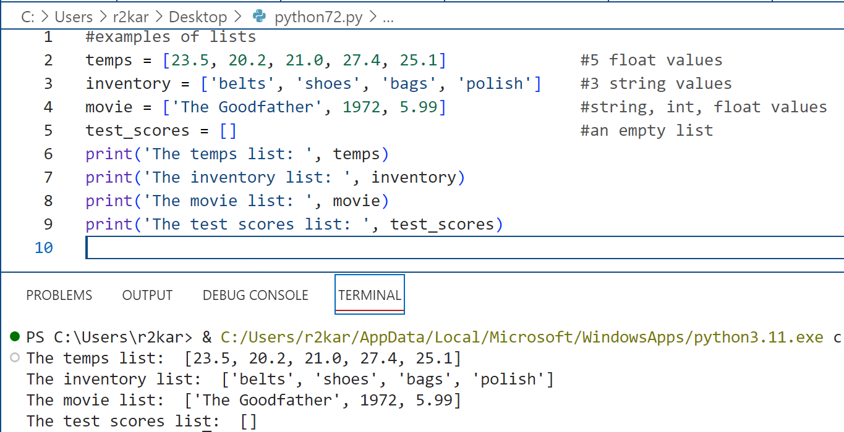
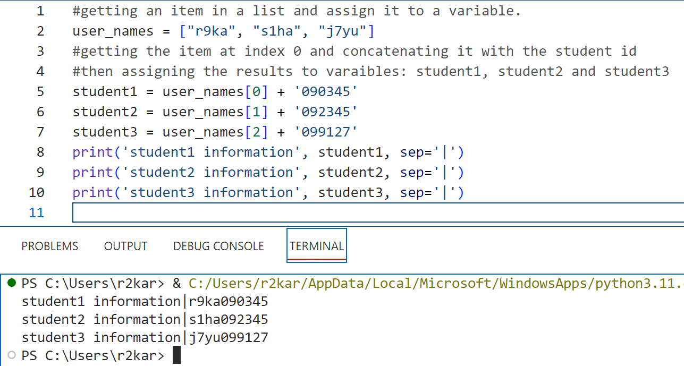
Data Types- Lists
Working with Lists: Examples

Slide 8
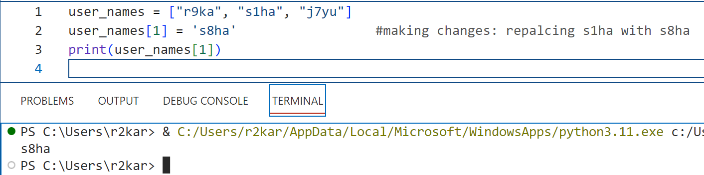
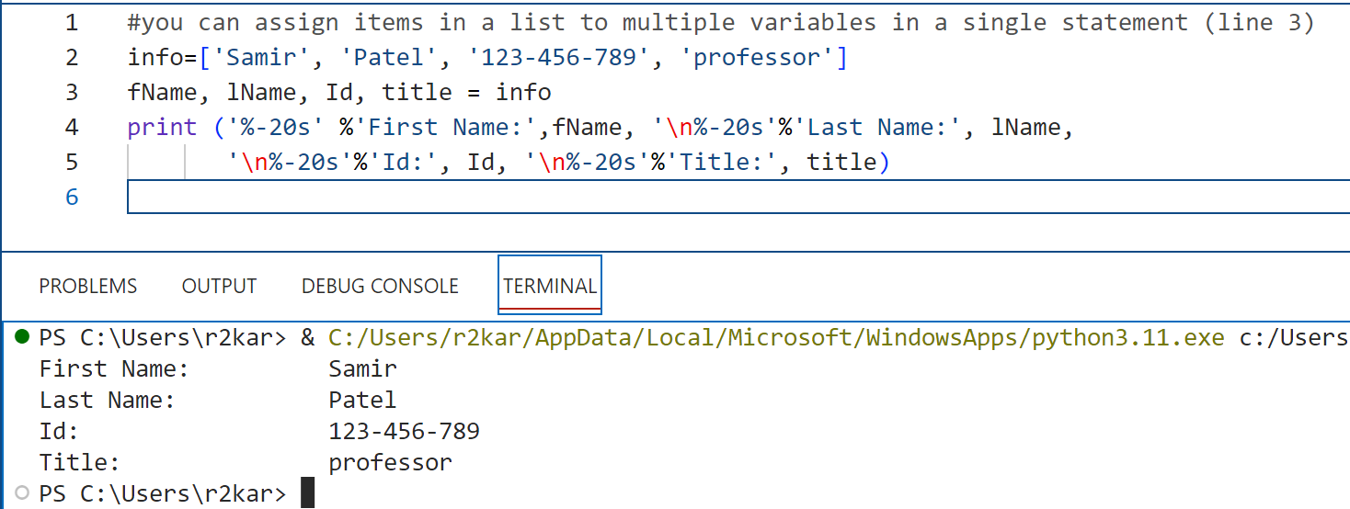
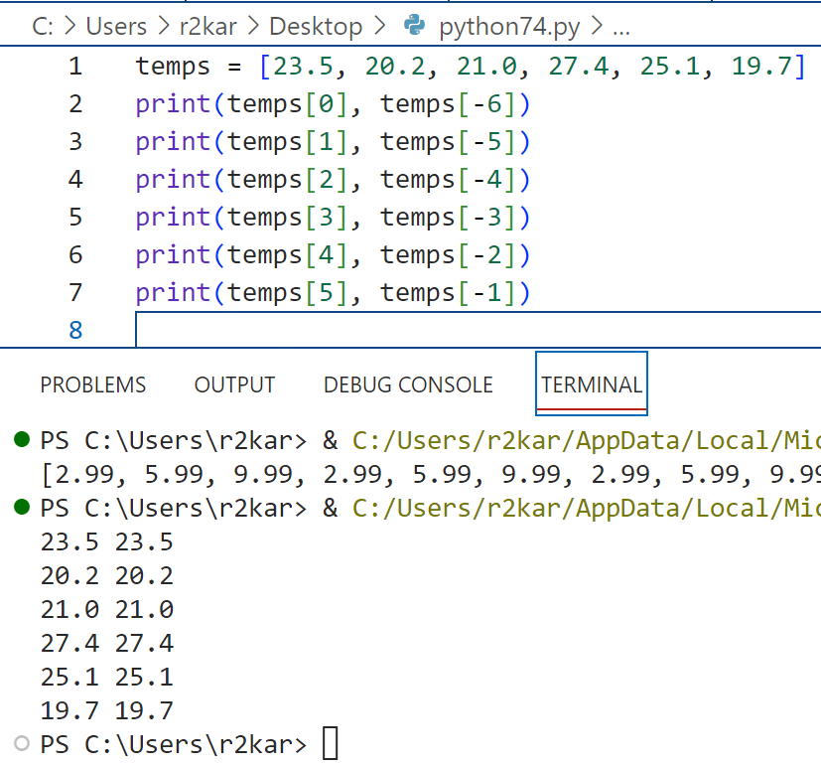
Data Types- Lists
Working with Lists: Examples

Slide 9
Data Types- Lists
Working with Lists: slicing lists
You can slice a list to get a subset of the original list.
If you only want to supply start and end arguments, you only need to code one colon.
If you want to start slicing at the beginning of the list, you can omit the start argument. Or, if you want to continue slicing to the end of the list, you can omit the end argument.
If you include the step argument, it specifies which items in the list should be included. If, for example, you want to get every other item in the list, you can supply a step argument of 2. Or, if you want to reverse the items, you can supply a step argument of -1.

Slide 10
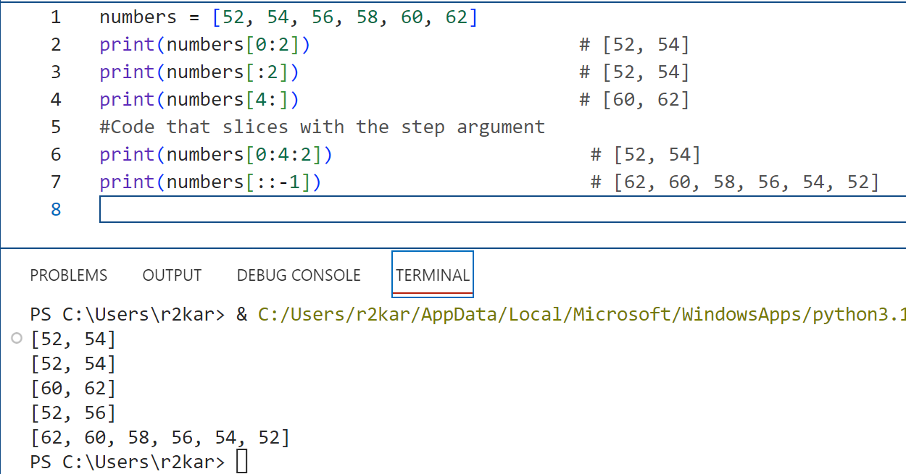
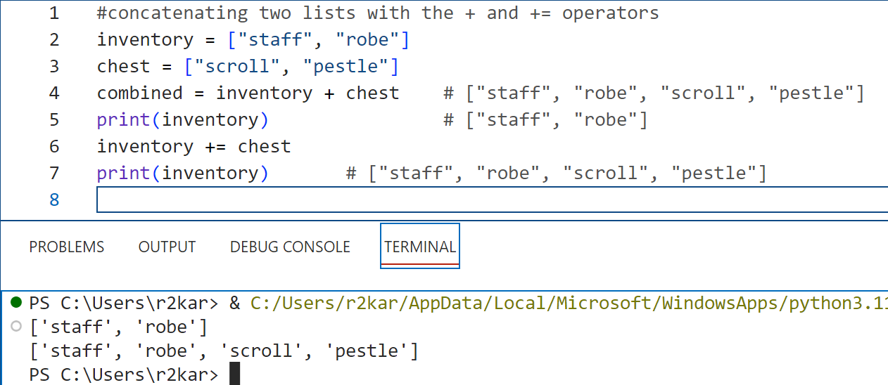
Data Types- Lists
Working with Lists: Examples for slicing and concatenating lists

Slide 11
Data Types- Lists
Working with Lists: copying lists
The assignment operator makes a shallow copy of a list, so both list variables refer to the same list. Since a list is a mutable type, this causes both variables to refer to the same list. As a result, if you use one variable to change the list, those changes are also available to the other variable.
By contrast, the deepcopy() function of the copy module makes a deep copy of the list, so the list variables refer to two different lists.
You have to import the copy module in order to use the deepcopy() function. As a result, you can use one variable to change items in one list, and you can use the other variable to change the items in the other list.

Slide 12
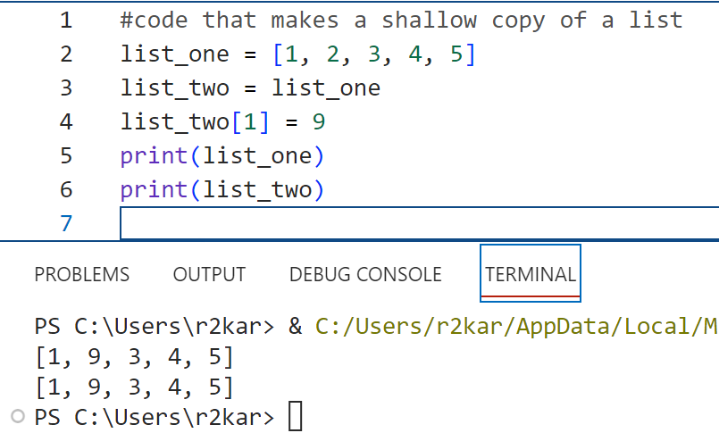
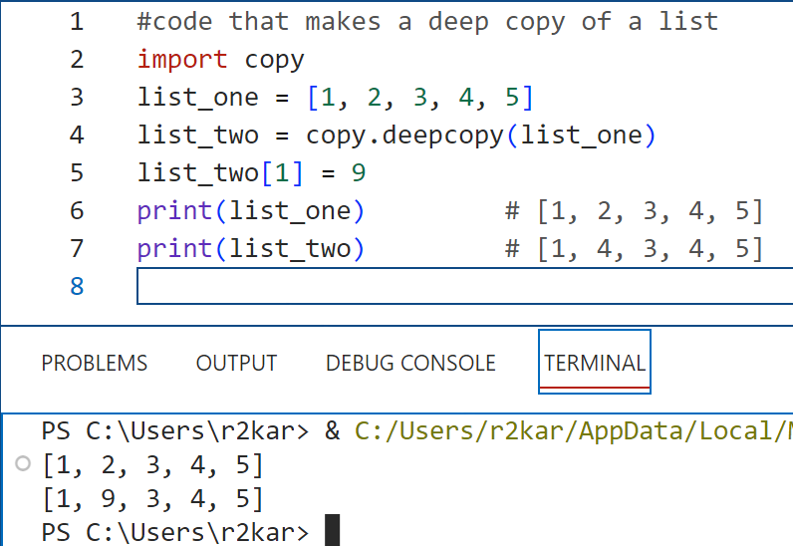
Data Types- Lists
Working with Lists: Examples for copying lists

Slide 13
Data Types- Lists
Working with Lists: creating a list of lists
To create a list of lists, you code another list within each item of a first list. This takes what you learned about lists and applies it to a list of lists.
To refer to the items in a list of lists, you use two indexes. If necessary, you can also use negative indexes to work from the end of each list.
This can also be referred to as a two-dimensional list, and you can think of the data as columns within rows.

Slide 14
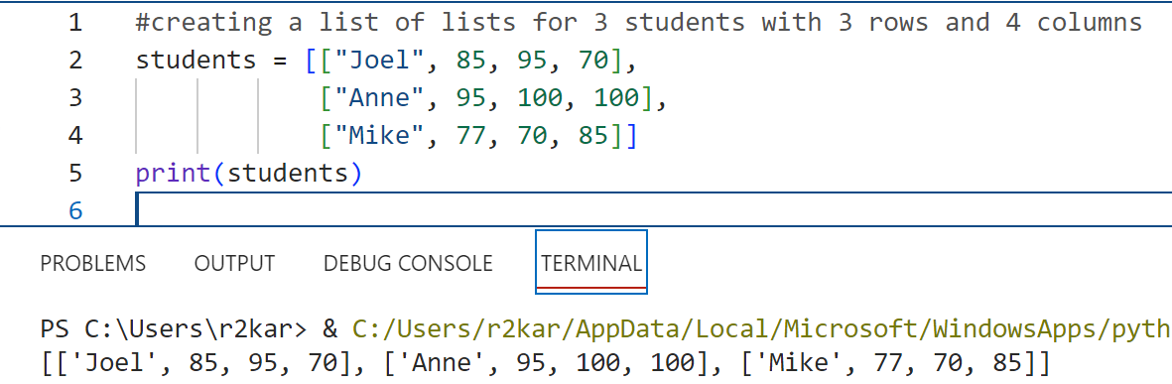
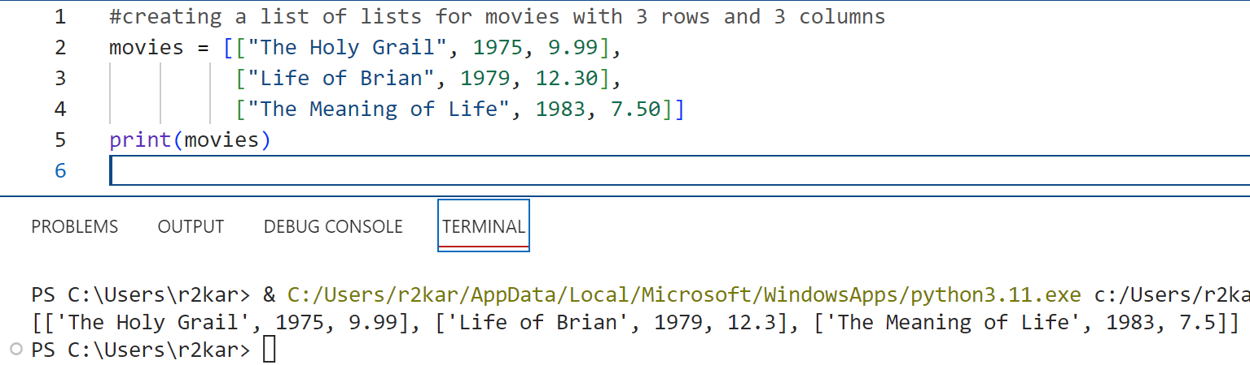
Data Types- Lists
Working with Lists: Examples of creating a list of lists

Slide 15
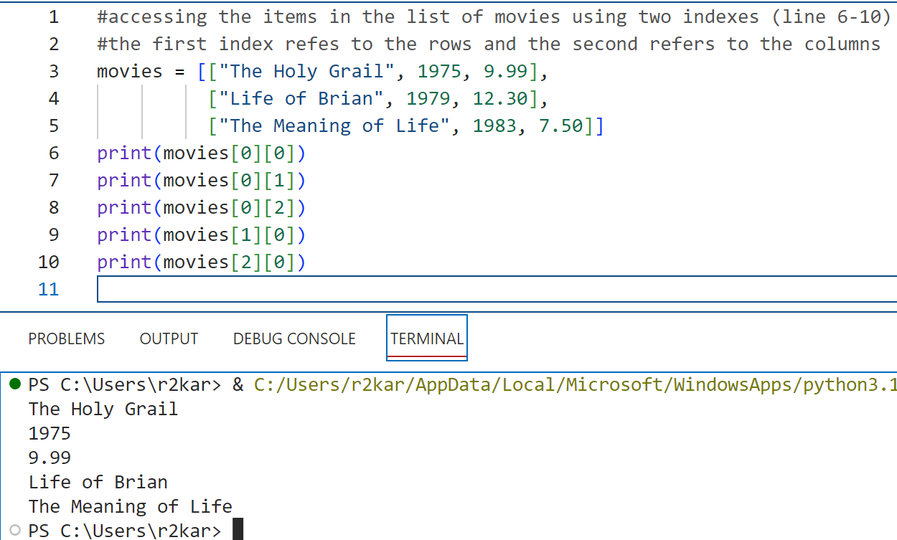
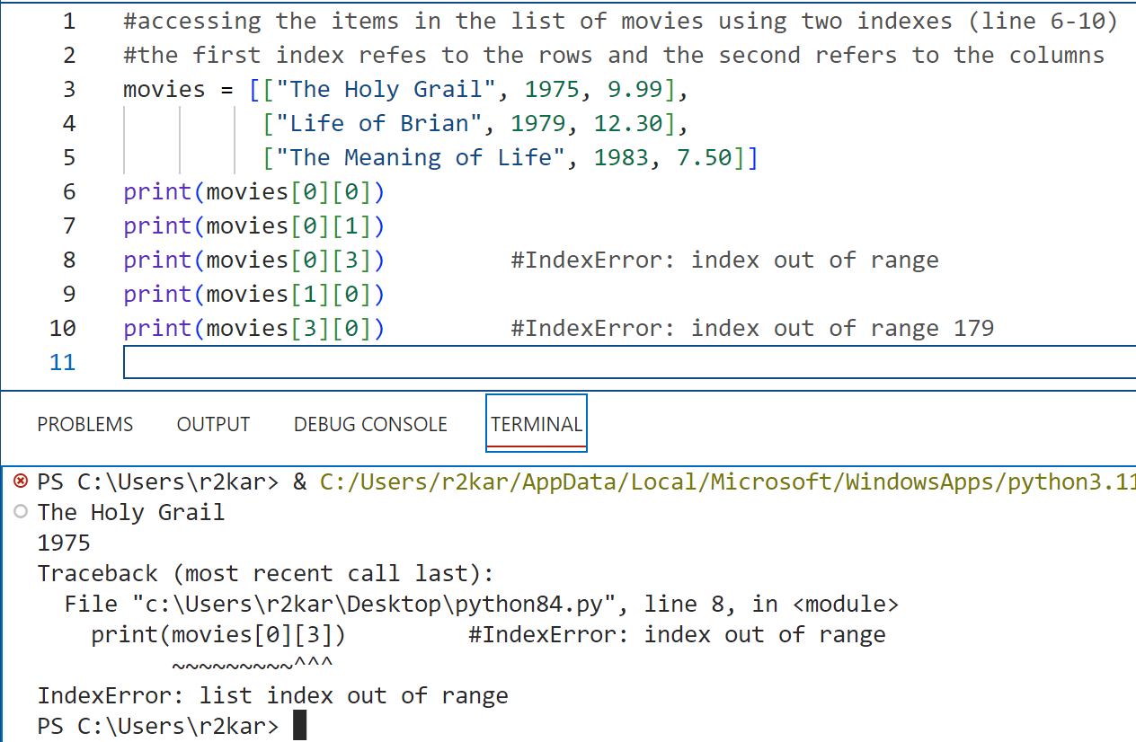
Data Types- Lists
Working with Lists: Examples of creating a list of lists

Slide 16
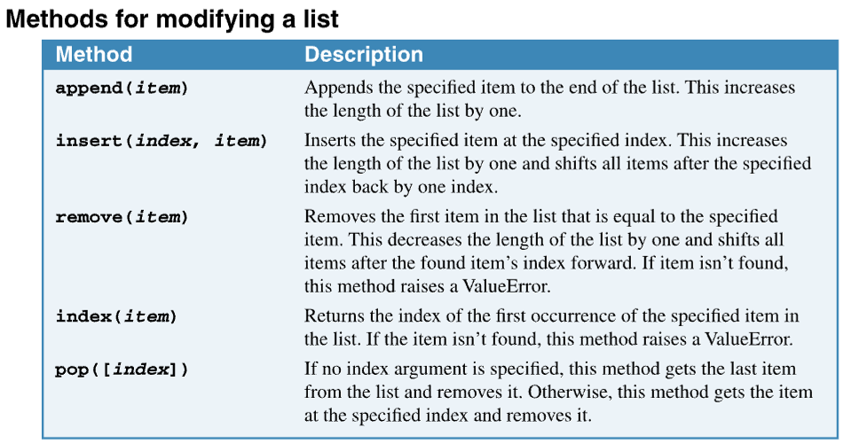
Data Types- Lists
Working with Lists: Methods for modifying a list
You can use the list methods to add and remove the items in a list.
You can add items to a list and remove items from a list. To do that, you can use some of the methods that are available for a list. These are summarized in the table shown to the right.

Slide 17
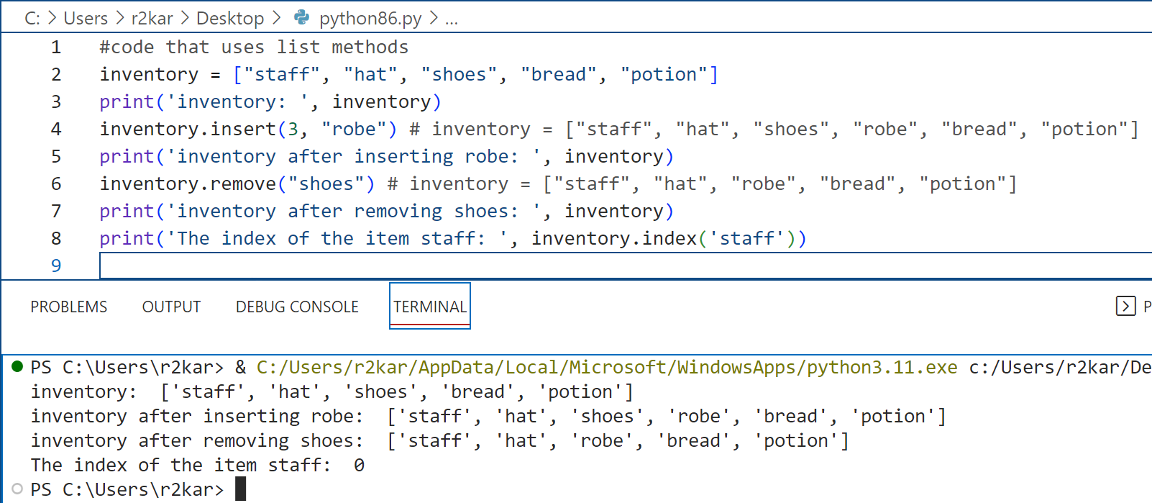
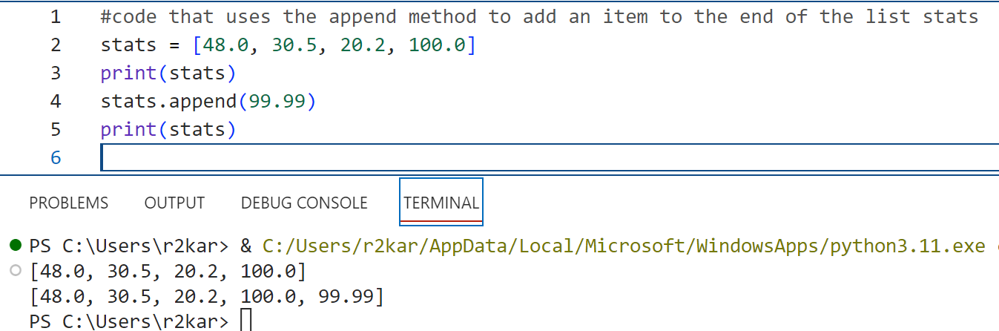
Data Types- Lists
Working with Lists: Examples for list methods

Slide 18
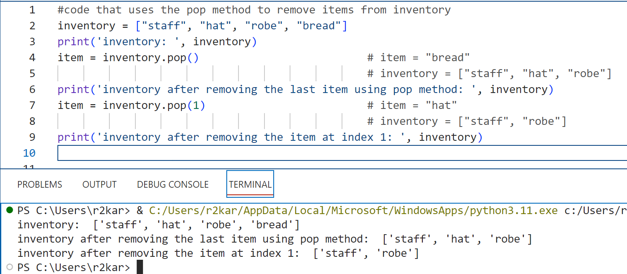
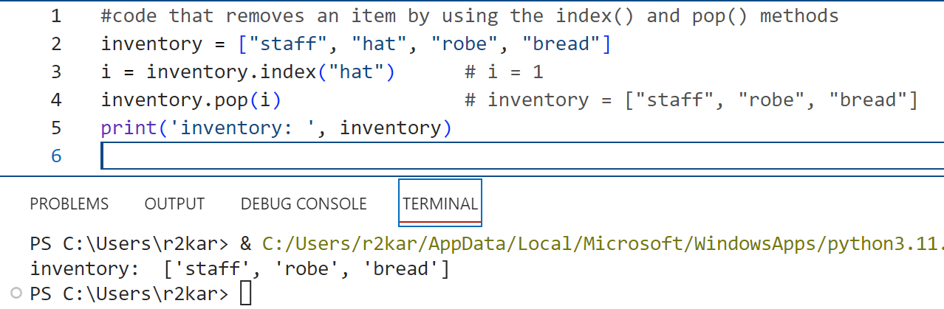
Data Types- Lists
Working with Lists: Examples for list methods

Slide 19
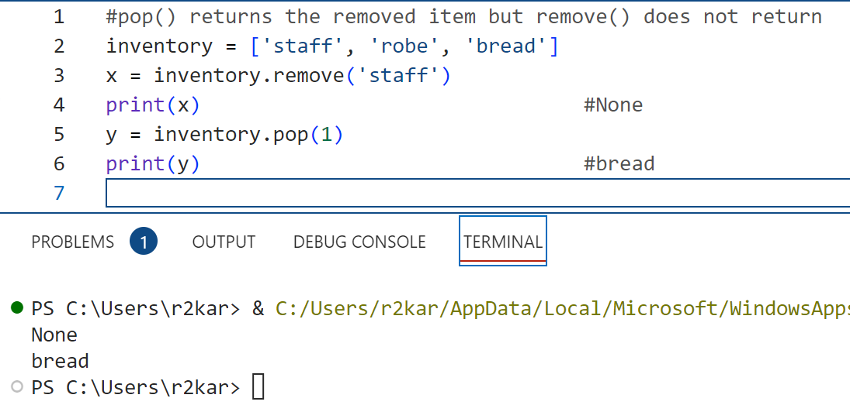
Data Types- Lists
Working with Lists: Methods for modifying a list
What is the difference between remove() and pop()?
Remove() takes the item itself as an argument to remove; however, pop() takes an index of an item as an argument to remove.
pop() returns the item removed so you can assign to a variable; however, remove() doesn’t return.

Slide 20
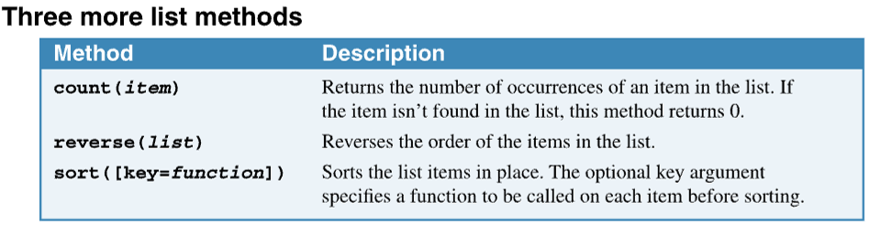
Data Types- Lists
Working with Lists: Methods for modifying a list
There are three other methods: count(), reverse() and sort().
The sort() method requires a second argument if the list contains strings with mixed cases. That’s because uppercase letters come before lowercase letters when strings are compared.

Slide 21
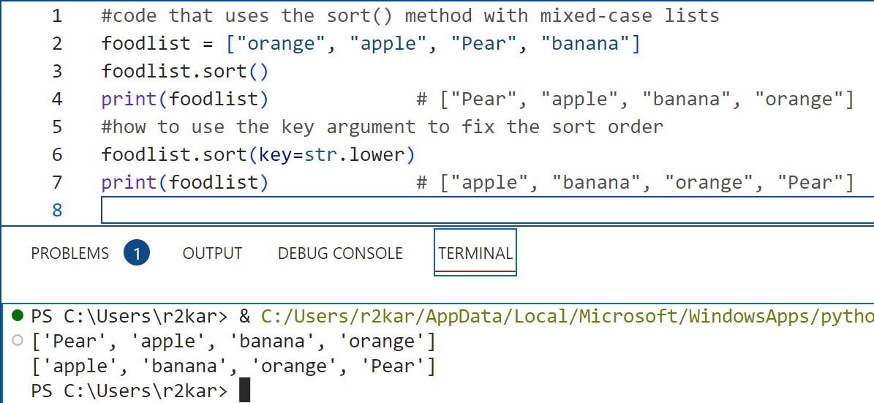
Data Types- Lists
Working with Lists: Methods for modifying a list

Slide 22
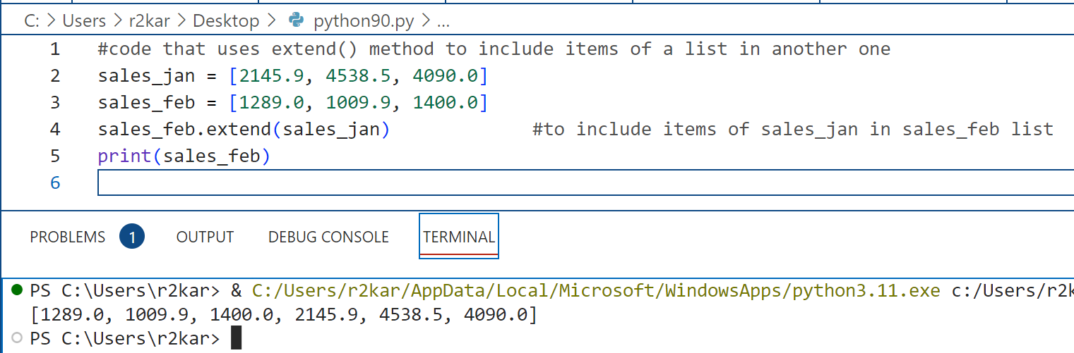
Data Types- Lists
Working with Lists: Methods for modifying a list
There is another useful method: extend().
You can use this method to extend a list to include items of another list.

Slide 23
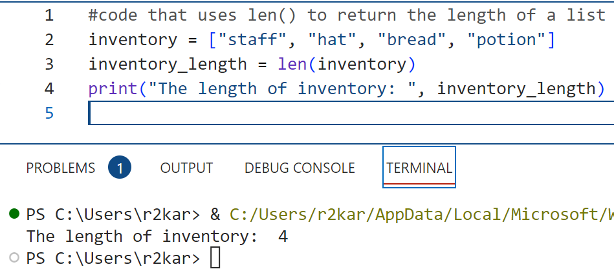
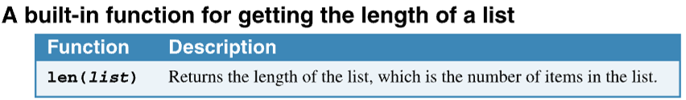
Data Types- Lists
Working with Lists: Functions for processing list items
You can use the built-in len() function to get the length of the list, which is the number of items in the list.
If, for example, there are 10 items in a list, the indexes range from 0 through 9, but the len() function returns 10.

Slide 24
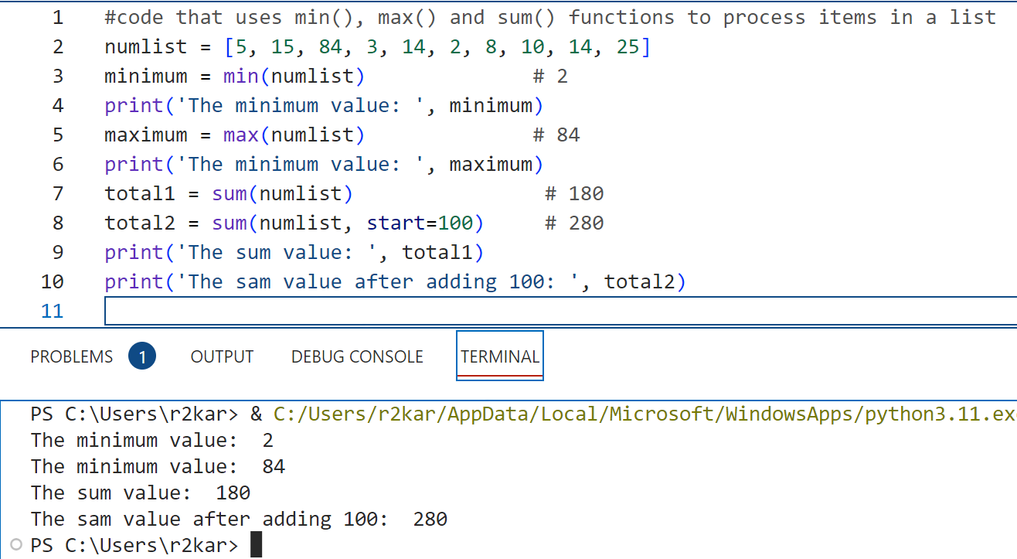
Data Types- Lists
Working with Lists: Functions for processing list items
You can use the min() function to get the lowest value in the list and the max() function to get the highest value.
You use the sum() function to get the sum of all the values in the list. You can include a value for the optional start argument. This adds the start value to the total that’s returned by sum().

Slide 25
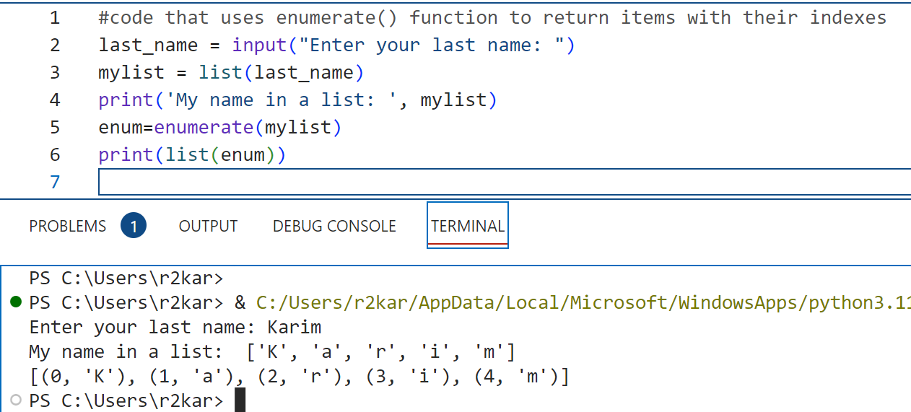
Data Types- Lists
Working with Lists: Functions for processing list items
You can use the enumerate() function to returns all the items with their corresponding indexes.

Slide 26
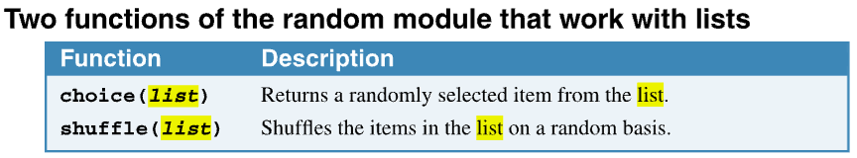
Data Types- Lists
Working with Lists: Functions for processing list items
Later, we will learn about functions. At this point, we want to know how to use some useful functions of Module random to process list items.
The random module provides functions for generating random numbers. One of its uses is for game development.
You can use the choice() function to get a randomly selected item from a list. Here, choice is used as the variable name to hold the returned randomly selected item.
You can use the shuffle() function to shuffle the numbers in a list.

Slide 27
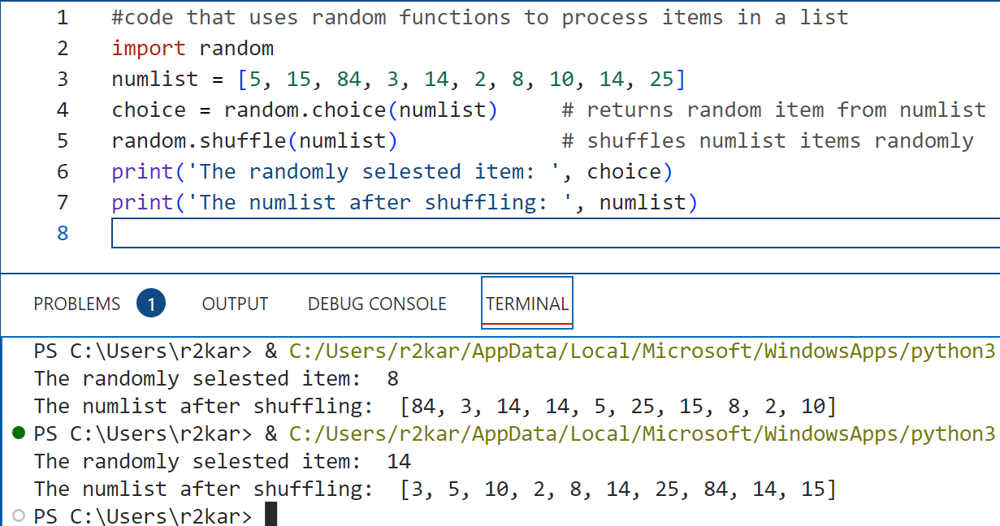
Data Types- Lists
Working with Lists: Functions for processing list items

Slide 28
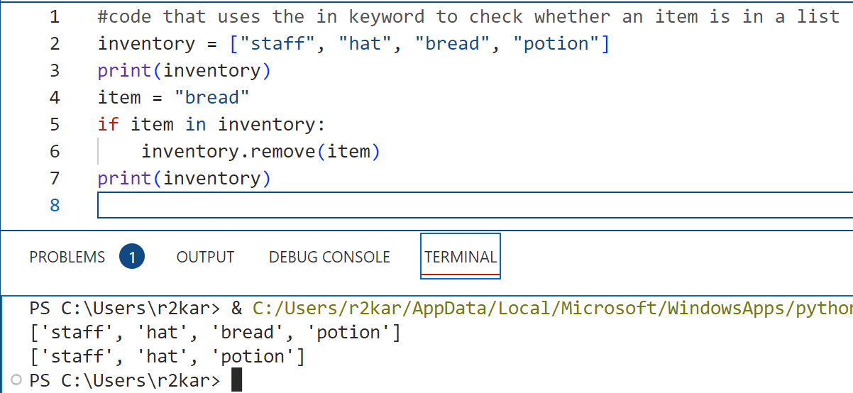
Data Types- Lists
Working with Lists: Functions for processing list items
You can use the in keyword to search for an item in a list. This is one way to make sure that an item is in a list before you process it. In this example, the item is removed after the code makes sure it’s in the list.

Slide 29
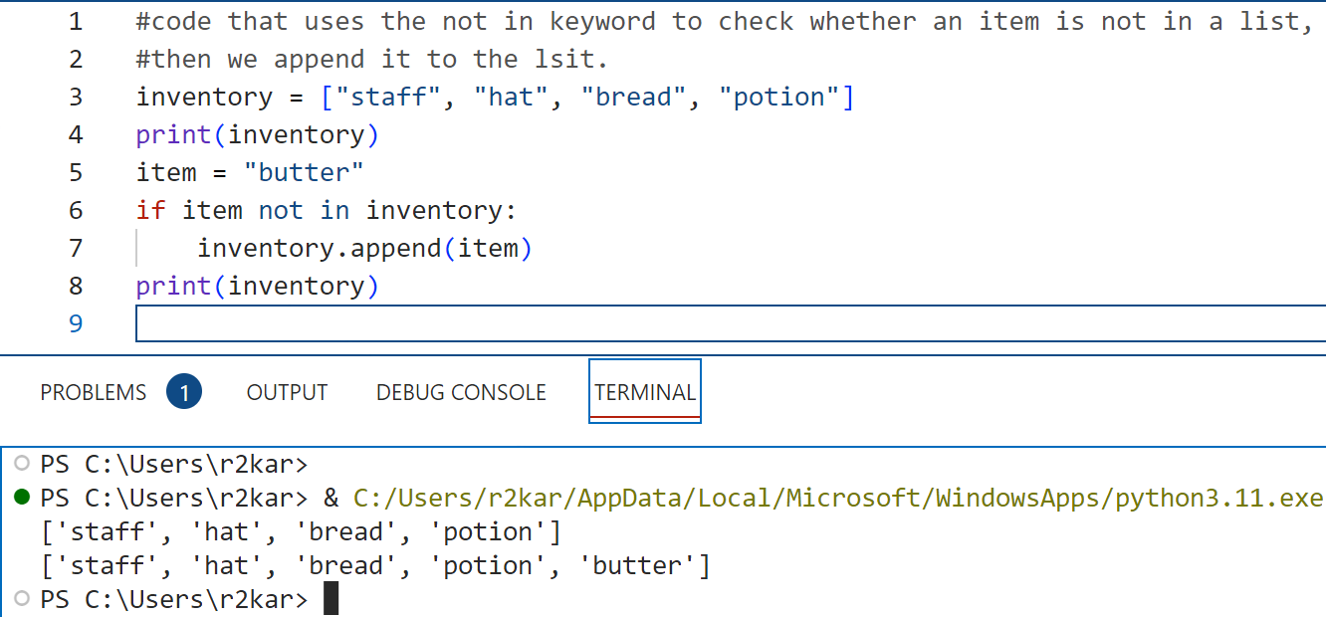
Data Types- Lists
Working with Lists: Functions for processing list items
In the same way, you can use the not in keyword to check if an item does not exist in a list. In this example, the item is appended to the list after the code makes sure it’s not in the list.

Slide 30
Data Types- Lists
Working with Lists: Functions for processing list items
There is a built-in function range(), that can be used to automatically generate regular arithmetic sequences.
The range() is useful when you need to generate a list sequence.
The range() syntax is shown to the right:
range(n) | Where n is the number of elements; the first element is index 0, and last n-1
range(n, m) | start at n and stop at m-1
range(begin, end, step) | Begin, increment by step, stop at end-1

Slide 31
Data Types- Lists
Working with Lists: Functions for processing list items
There is a built-in function range(), that can be used to automatically generate regular arithmetic sequences.
The range() is useful when you need to generate a list sequence.
The range() syntax is shown to the right:
range(n) | Where n is the number of elements; the first element is index 0, and last n-1
range(n, m) | start at n and stop at m-1
range(begin, end, step) | Begin, increment by step, stop at end-1

Slide 32
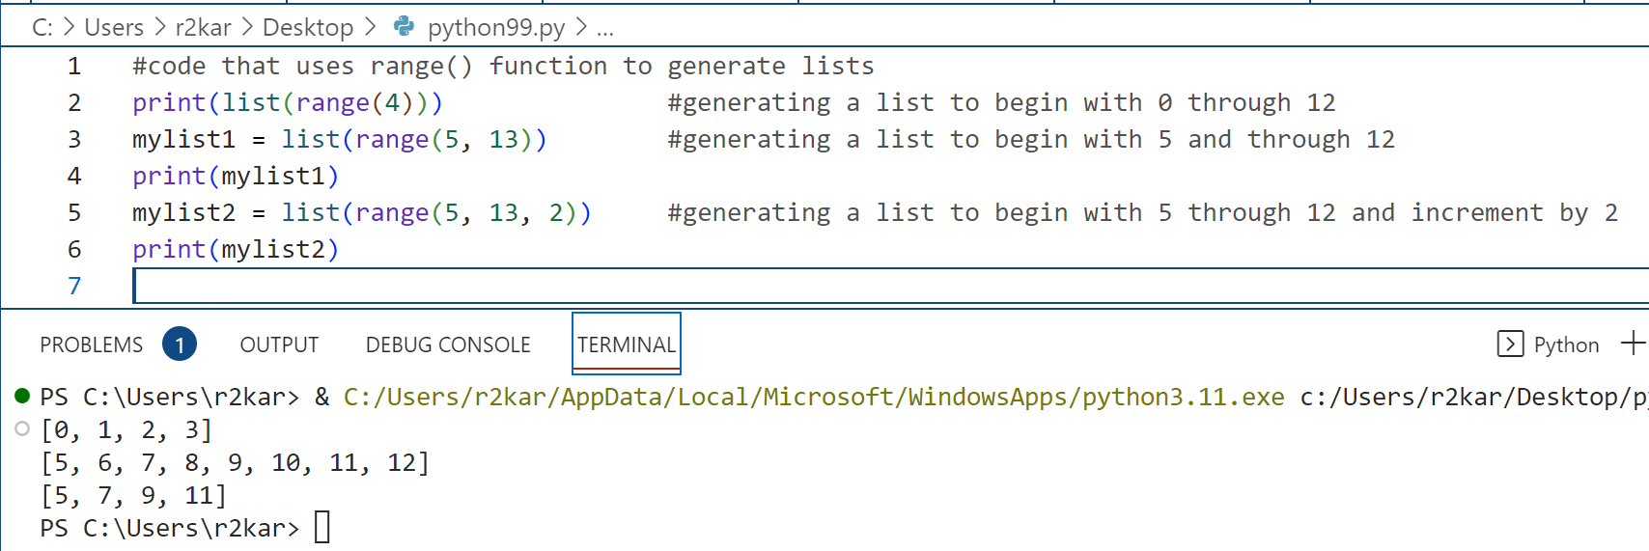
Data Types- Lists
Working with Lists: Functions for processing list items

Slide 33
Data Types- Lists
Working with Lists:Do it yourself !
Ask the user to enter first name, last name and a student id, all in one input statement.
Create an empty list, then append the entered information into the list using append() one at a time.
Last, print the list.

Slide 34
Data Types- Lists
Working with Lists: Do it yourself !
Ask the user to enter 4 sales amounts as float values, all in one input statement separated with ( , ).
Append them into a list.
Find the minimum, maximum, the sum of the list of the sales.
Sort the list then reverse it.
Last, count the number of times an amount occurs in a list.
Print out all outputs in the above questions.

Slide 35
Data Types- Lists
Working with Lists: Do it yourself !
Create a list of 3 subjects you take in your school.
Create another list of the 3 grades of the subjects.
Extend the first list to include the second one.
Check for a specific subject if it is in the list, if so, remove it with its grade. If the subject is not in the list, append it with its grade into the list so it still looks consistent- the subjects followed by the grades.
Calculate the average of the grades. In a new list, append or extend it to include the subjects and the average value.
Get the average value from the list and check for it to print the corresponding grading letter (e.g., A, B, C, etc.) – follow the example in the last week lesson.
A sample of the extended list:
['math', 'python', 'network', 90, 93, 88]

Slide 36
Data Types- Lists
Working with Lists: Do it yourself !
Create a list of three lists of 2 float numbers in each.
Access the second list.
Compare the two values of that list.
If they are equal, append ‘neutral’ to the list, if the first value is smaller than the second, append ‘safe’; otherwise, append ‘risky’.
Access the appended value in the previous step and print out to the screen.

Slide 37
References
Material has been taken from (can be accessed through Sheridan's Library Services) :
Starting Out with Python (ISBN-13: 9780136912330 ):
https://www.pearson.com/en-ca/subject-catalog/p/starting-out-with-python/P200000003356/9780136912330
Murach’s Python 2nd Edition programming, 2nd Edition :
https://bookshelf.vitalsource.com/reader/books/9781943872756/pages/recent
Introducing Python, Lubanovic, B., O'Reily Media, 2nd Edition, 2019
https://www.oreilly.com/library/view/introducing-python-2nd/9781492051374/

